Slide 1

Edward Hines Jr. VA Hospital Employee Recognition/Award Application
Current State, Flow Mapping,
App Preview, & Future State
Kyle J. Coder,
Program Analyst,
Informatics and Advanced Analytics Team
April 9, 2025 https://dvagov.sharepoint.com/sites/vhahin/svc/ci/

Slide 2
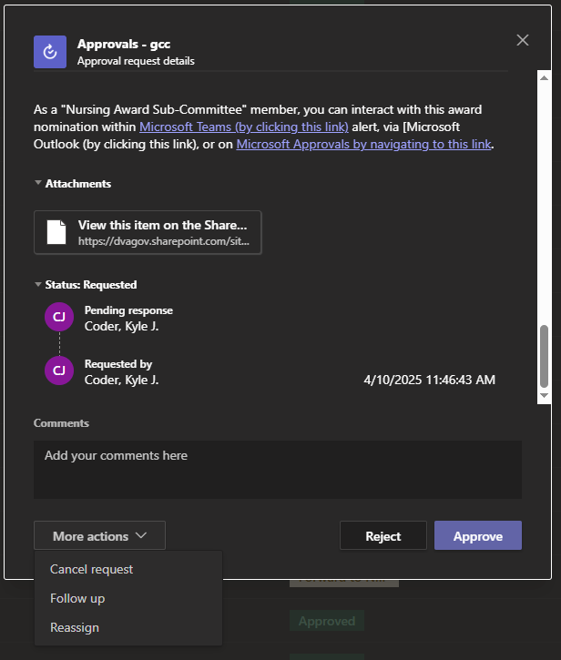
Employee Recognition Application
View the submitted award packet’s information in an easy-to-read table
Click this link to generate a downloadable file for this award packet
Click “Approve” button, to acknowledge the submitted award packet has been chosen to formally ‘win’ the specified award
Award Triage Automation & Routing Flow Infographic Guide
Click “Reject” button to indicate this award packet was not chosen to formally ‘win’, but to officially acknowledge receipt & consideration
Add any free-text comments or additional context that you want to permanently recorded about the action that you are about to submit on this award packet
Use the “More actions” button to:
Permanently cancel this award packet entirely without consideration, or
Request a follow up from the submitting person, or
Identify a specific individual(s) that you want to reassign this approval packet to instead of yourself
Kyle J. Coder, Program Analyst, Informatics and Advanced Analytics Team
April 9, 2025

Slide 3
Employee Recognition Application
View the submitted award packet’s information in an easy-to-read table
Click this link to generate a downloadable file for this award packet
Click “Approve” button, to acknowledge the submitted award packet has been chosen to formally ‘win’ the specified award
New Award Packet Automation / Routing Flow Infographic Guide
Click “Reject” button to indicate this award packet was not chosen to formally ‘win’, but to officially acknowledge receipt & consideration
Add any free-text comments or additional context that you want to permanently recorded about the action that you are about to submit on this award packet
Use the “More actions” button to:
Permanently cancel this award packet entirely without consideration, or
Request a follow up from the submitting person, or
Identify a specific individual(s) that you want to reassign this approval packet to instead of yourself
Kyle J. Coder, Program Analyst, Informatics and Advanced Analytics Team
April 9, 2025

Slide 4
App Flow Map
Definitions:
App User: Any individual employee of Hines who wants to recognize another employee’s great work by loading & using this application
Award Packet: The information written by the App User, collected within this application, and submitted to storage & automation
Triage Team: Initially receives all submitted Award Packets from App Users, and re-routes it to the most appropriate Award Review Team
Award Review Team: Receives triaged packets that are unique to their specific award (HRO to HRO, Daisy/Bee to Nursing, Hines Hero to PubAffairs, etc.)
App User runs app
You Notify Winners
App User “Submits” Award Packet
App User answers “Award Specific Questions”, unique to their intended award type
Award Review Team chooses award winners I.A.W. current guidelines & selection criteria
Application loads & pulls current data from SharePoint & ActiveDirectory
Application saves data to SharePoint & routes packet to Triage Team via Microsoft Approvals
Application updates record storage with Triage Actions, & compiles detailed Award Packet for routing to Award Review Team
Application displays “Landing Page”, allowing App User to click “Start New Award Packet” button or review previous submissions
App User answers “Preparatory Questions” that use algorithmic / logic gates to identify award type and demographics
Triage Team reviews submission & re-routes to specific Award Review Team

Slide 5
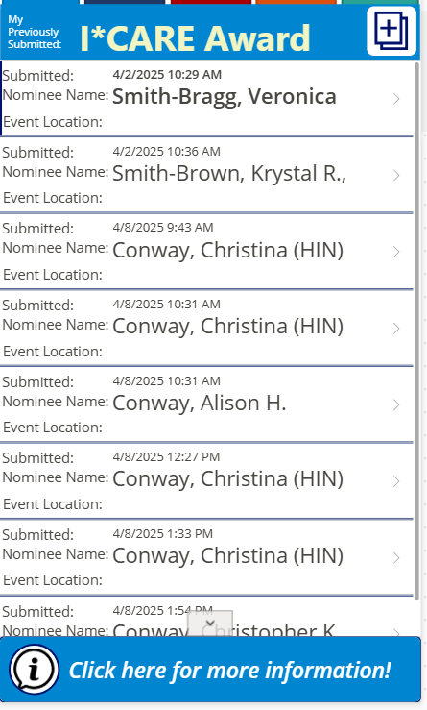
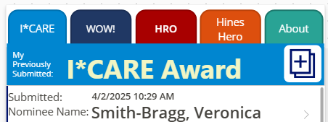
Application Landing Page:
Start a new award packet
Start a new award packet
*Disabled Currently* Tabs to view individual/ specific awards
Button to find more general info the app, submit bugs, or other info
Gallery of user’s previously submitted award packets
Gallery of user’s previously submitted award packets
Button to find more detailed general info about award

Slide 6
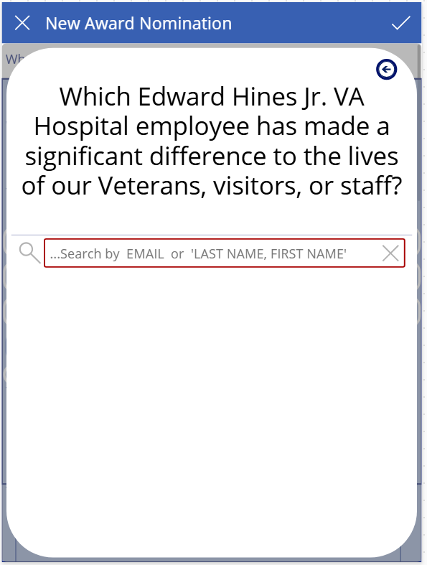
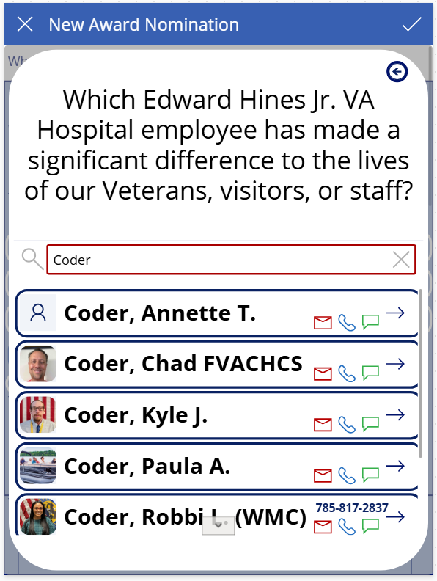
New Award: #1 Person Picker
Populates from Microsoft’s ActiveDirectory
Selecting any person will populate their info into all the next tabs & forms
Selecting any person also populates their profile info into the background data

Slide 7
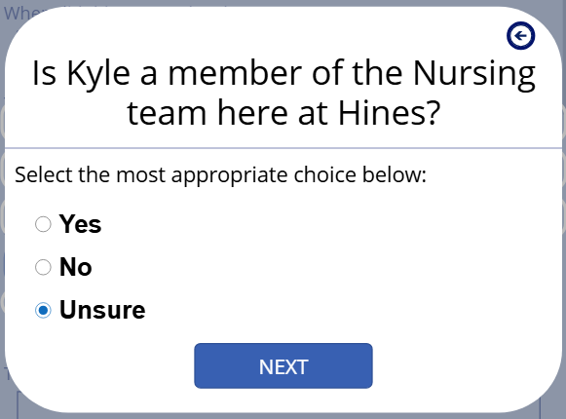
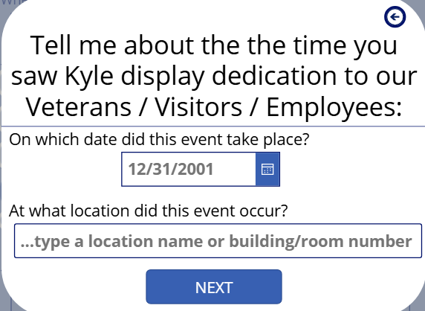
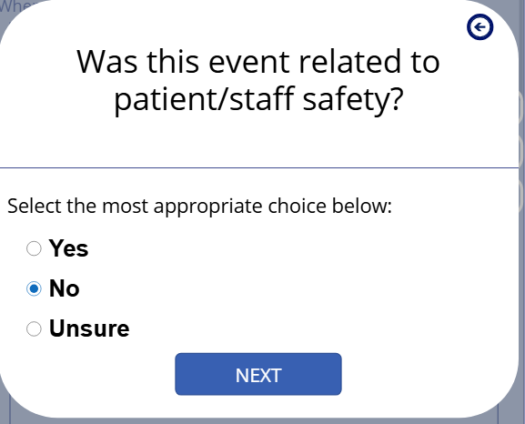
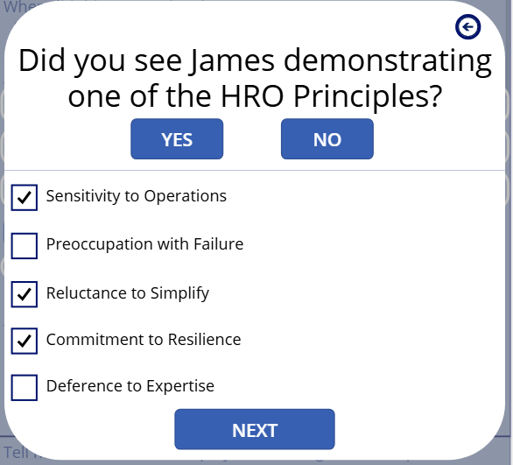
New Award: #2 Preparatory Questions
Algorithmic / Logic Gates to identify:
Nominee demographics
Event Date/Time
Event Location
Nursing Affiliated Nominee
Safety Related Event
Used to trigger automation and hidden flows to pre-fill as much info as possible without the App User being required to manually free text everything

Slide 8
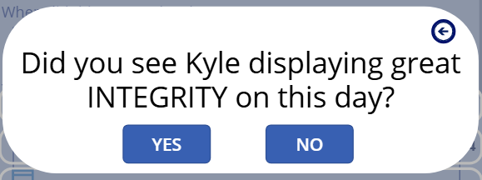
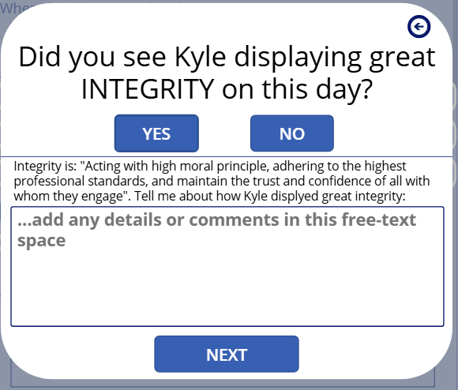
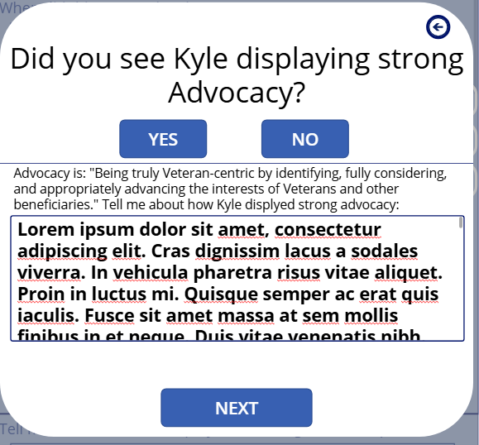
New Award: #3 Award Specific Questions
Interactable buttons hide / show detailed questions, definitions, & prompts, which allows App Users to quickly jump past sections that may be irrelevant to their current packet
Free-text boxes are available to type unlimited amounts of details

Slide 9
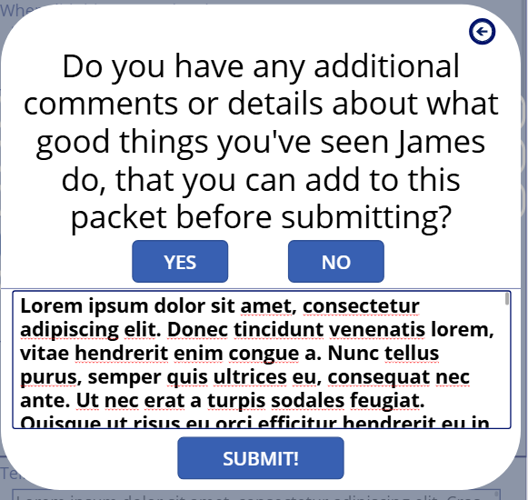
New Award: #4 Free-Text Additional Info
Allows optional free-text additional information to be added before submission

Slide 10
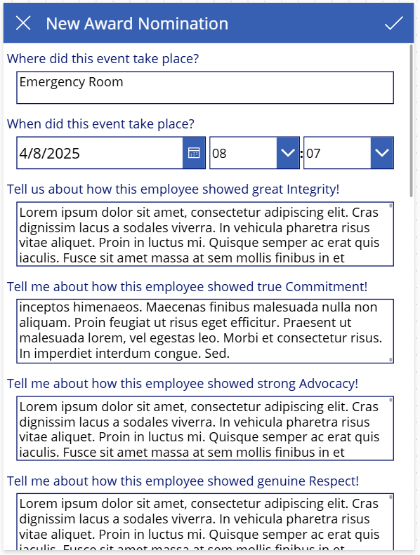
New Award: #5 Preview Before Submission
Allows the App User to review their prepared information prior to officially “Submitting” the finished Award Packet.
Can make any free-text changes to any data fields

Slide 11
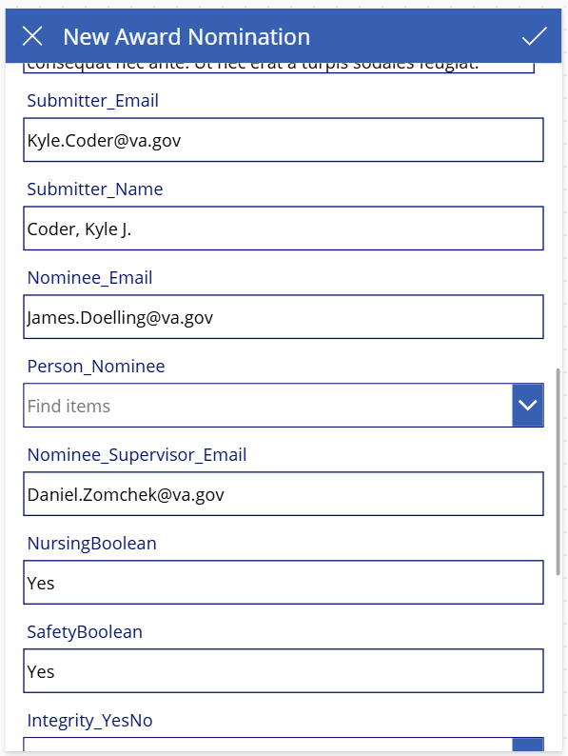
New Award: #5 Preview Before Submission
Allows the App User to review their prepared information prior to officially “Submitting” the finished Award Packet.
Can make any free-text changes to any data fields
Can cancel/exit the Award Packet without submission, going back to the app’s Landing Page

Slide 12
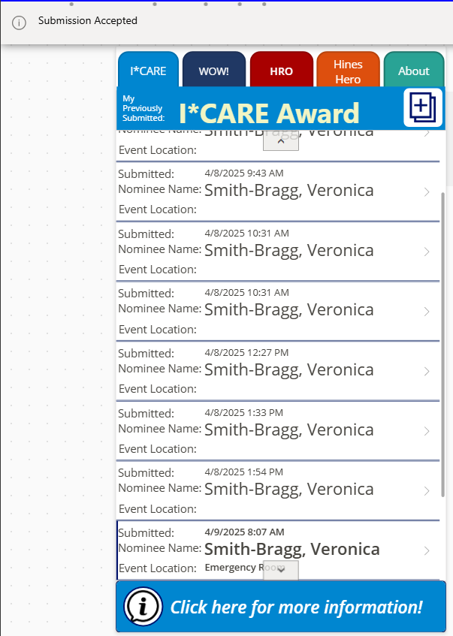
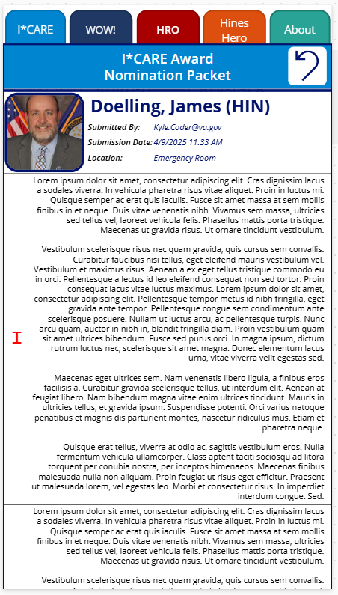
New Award: #6 Award Packet Submitted!
“Submission Accepted” banner is displayed
Application returns to Landing Page, with newly submitted Award Packet added to gallery as a clickable object
Clicking previously submitted Award Packets opens pop-up to display read-only version of details

Slide 13
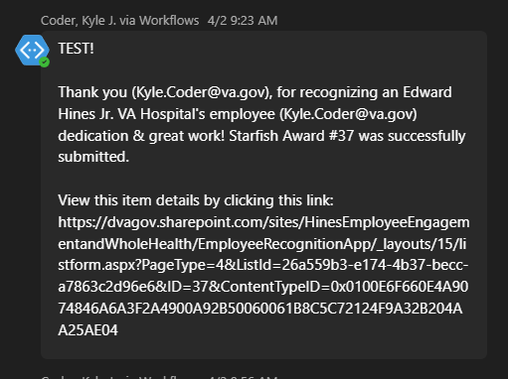
Automated Flow: #1 Submitter Thanks
Automatic Microsoft Teams message is sent to the App User for taking the time to recognize one of their fellow employees.

Slide 14
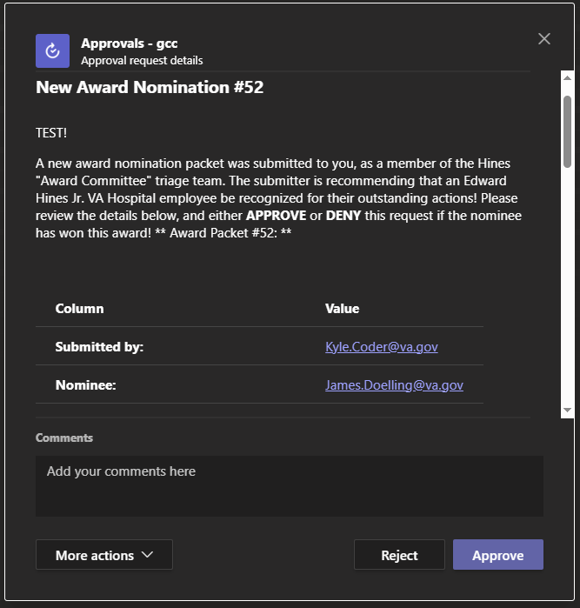
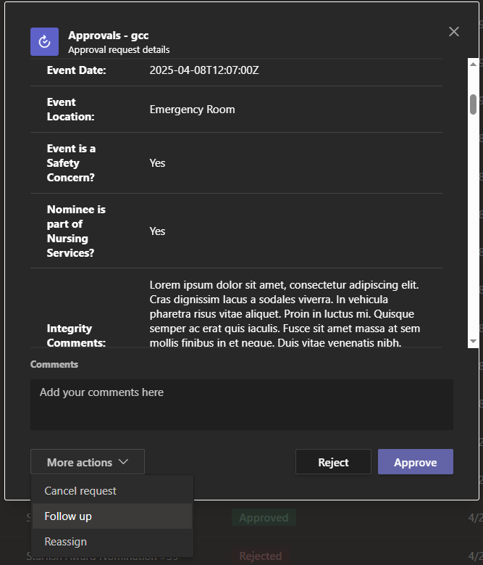
Automated Flow: #2 Triage Team Review
Automatic Microsoft Teams message is sent to the App User for taking the time to recognize one of their fellow employees.
Triage Team reviews summarized Award Packet, and can take various actions to:
Current Triage Team Members:
HSS Director Representative (HR/Disciplinary or Medical Media): Christina.Conway@va.gov
Quality Representative (HRO / Safety Story / HeRO): Tuesday.Majors@va.gov
Employee Engagement / VEO: Candice.Kent@va.gov & Darius.Franche@va.gov
Nursing Services (Daisy / Bee Awards): Teneshia.Hudson@va.gov & Kimberley.Richmond@va.gov
Re-assign request to the most appropriate Award Review Team / Sub-Committee
Request follow-up information about the submission from the App User
Reject the submission (for clear/blatant errors)

Slide 15
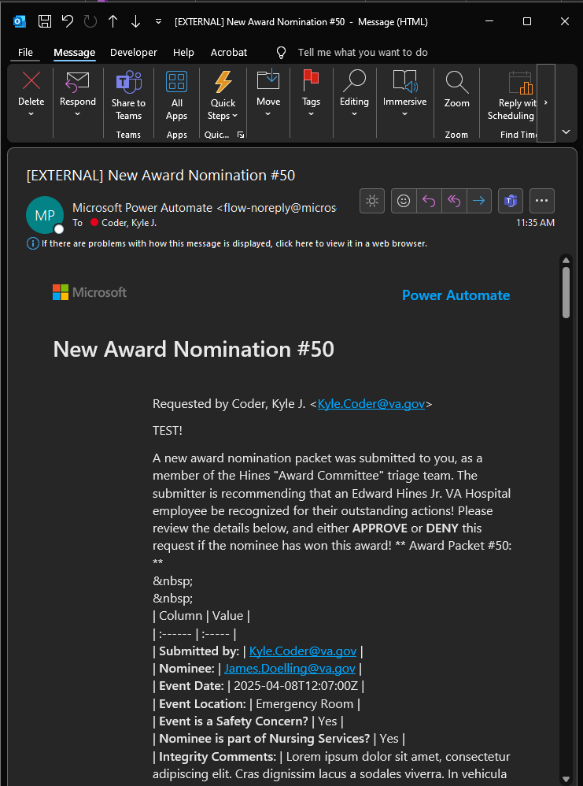
Automated Flow: #3 Award Review Team
Triage Team filters down packets to Award Review Team by re-assigning submissions that are only relevant to their specific Award’s needs or oversight:
Daisy/Bee Award -> Nursing Services
HRO/Safety Story/HeRO -> Quality/PSM Team
Hines Hero -> Public Affairs
Award Review Team notified of re-assignment via Microsoft Approvals and email, which both include the Award Packet details
*Current State* Award Review Team evaluates the submission using the already established criteria unique to each of the awards they govern. No further automation progresses after packet delivered to Award Review Team.
Current Award Review Team Members: No changes! Your colleagues that currently oversee awards remains the same!

Slide 16
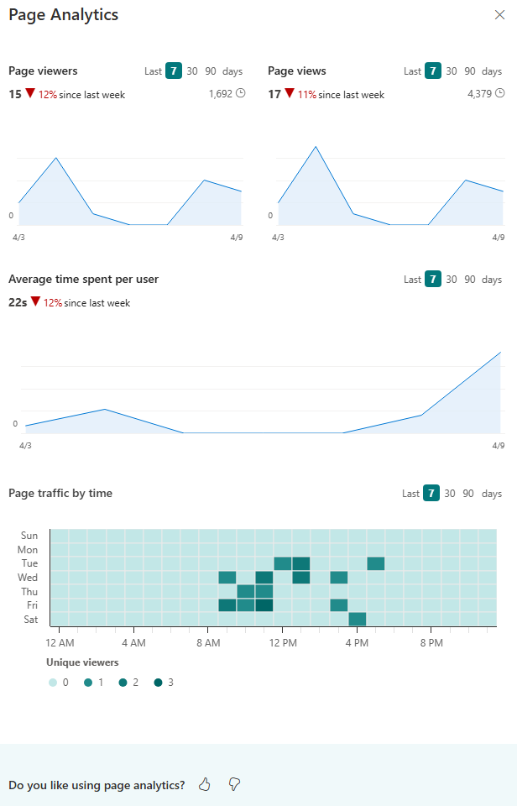
Automated Flow: Target State
PowerBI & within-App analytics and reports showing submissions by username, service line, nominee, location, subject/content, etc.
Automations for Award Review Team to respond to Microsoft Teams Chatbot to score/sort submissions in real time, allowing a consolidated monthly report with top scoring packets for formal selection
Automated notifications to Medical Media to schedule photographs or Print Shop to generate high-quality “award certificates” for winners
Automated emails/notifications to Service Chiefs/Supervisors of high-achieving subordinates, to prompt inter-team recognitions more regularly

Slide 17
Questions?
Kyle.Coder@va.gov https://dvagov.sharepoint.com/sites/vhahin/svc/ci/ tinyurl.com/2nwvddyw
Contact: SharePoint: Live App Link:

